Slide 1
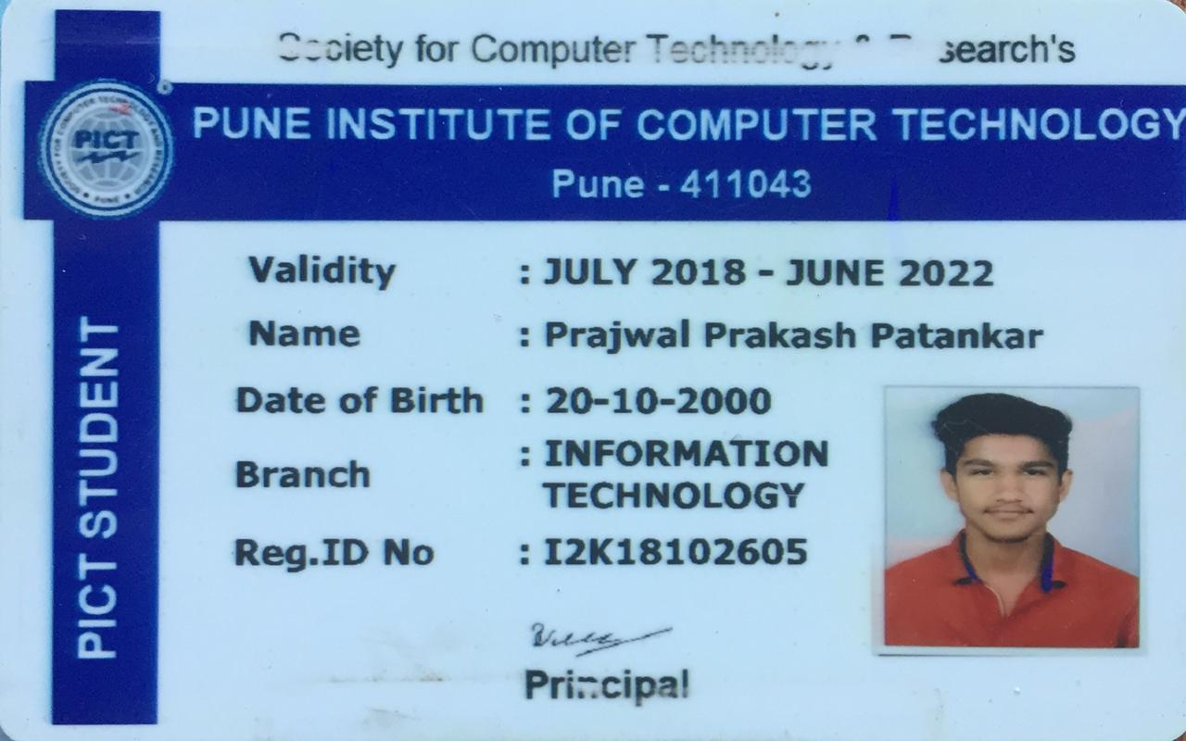
SL3 Assignment 1.1
TE – 10
Roll no : 33244
Bike recommendation website

Slide 2
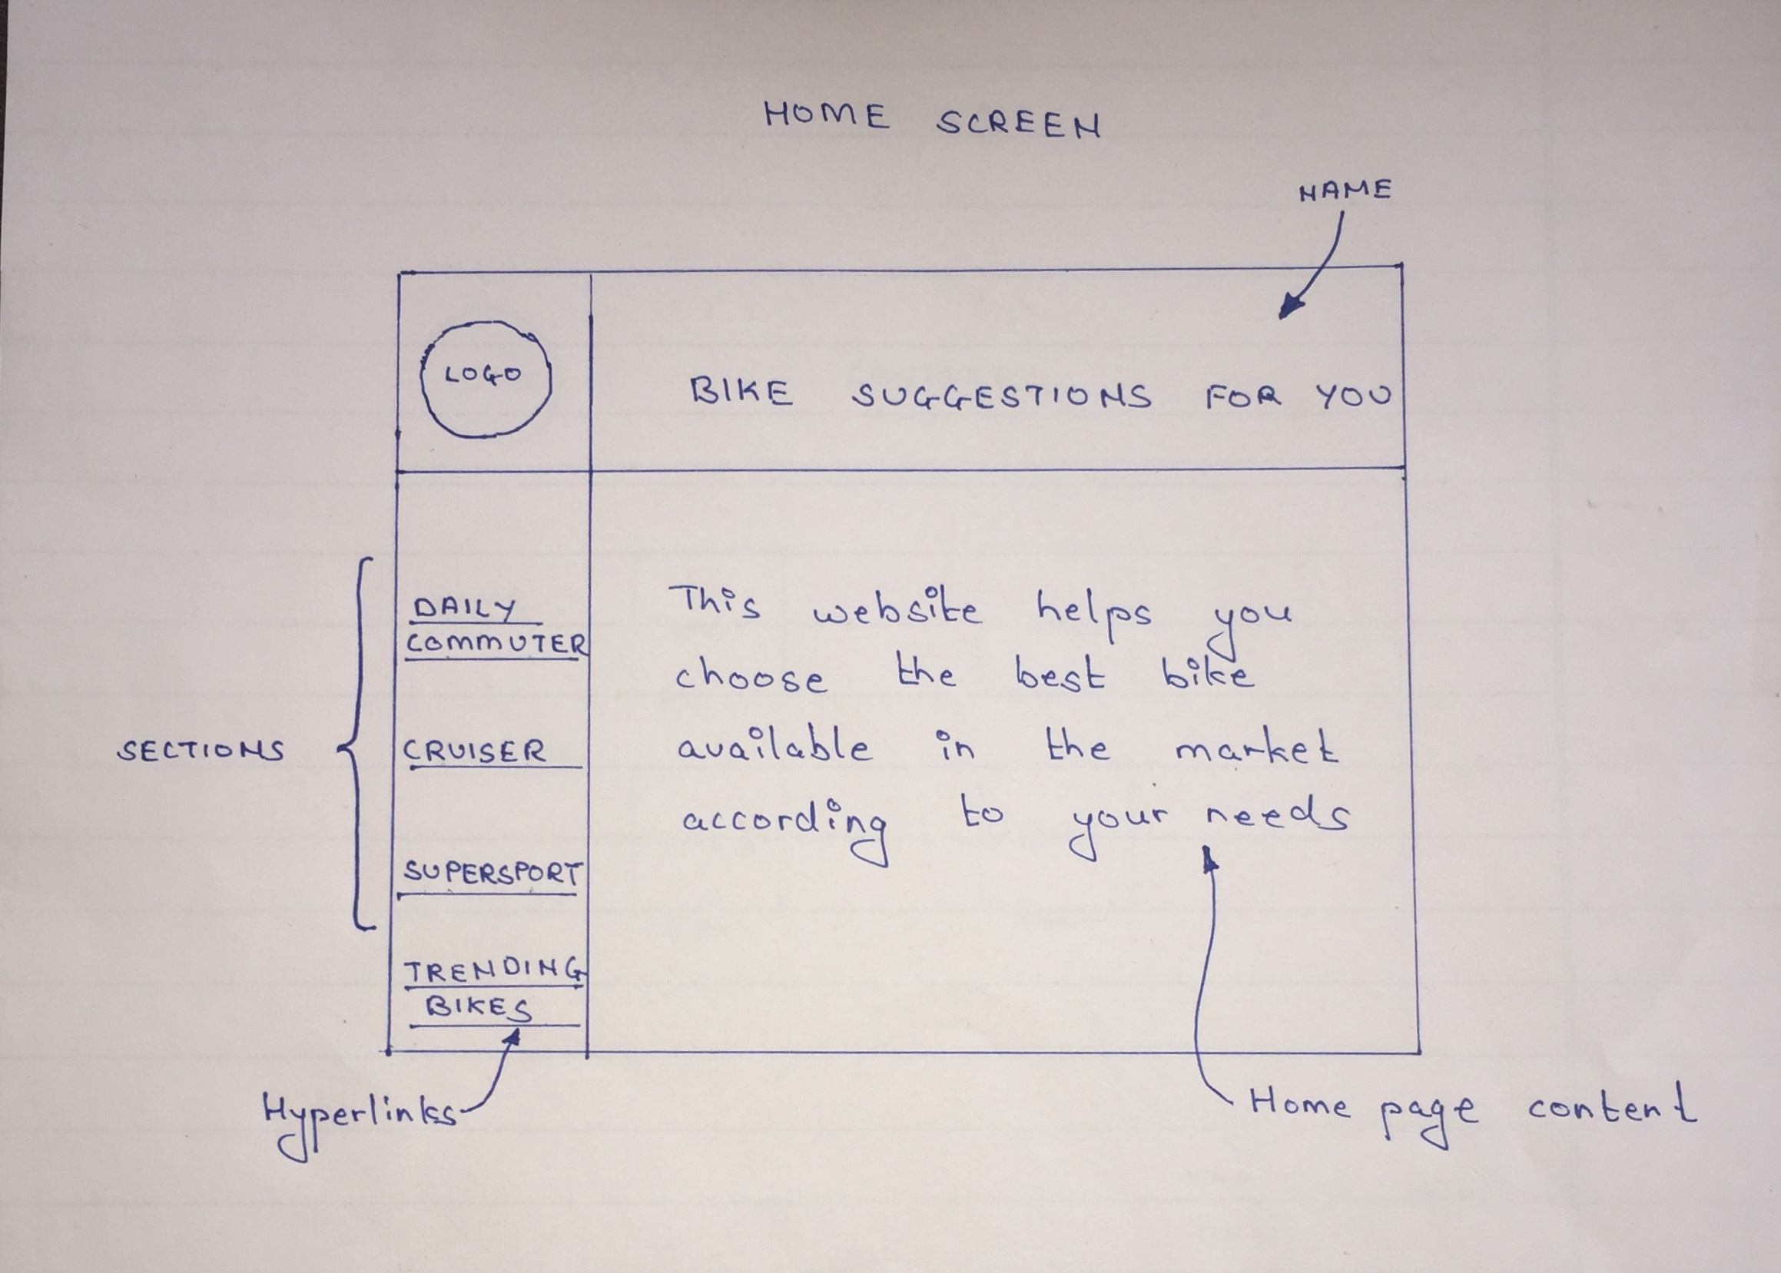
Home page (screen 1)

Slide 3
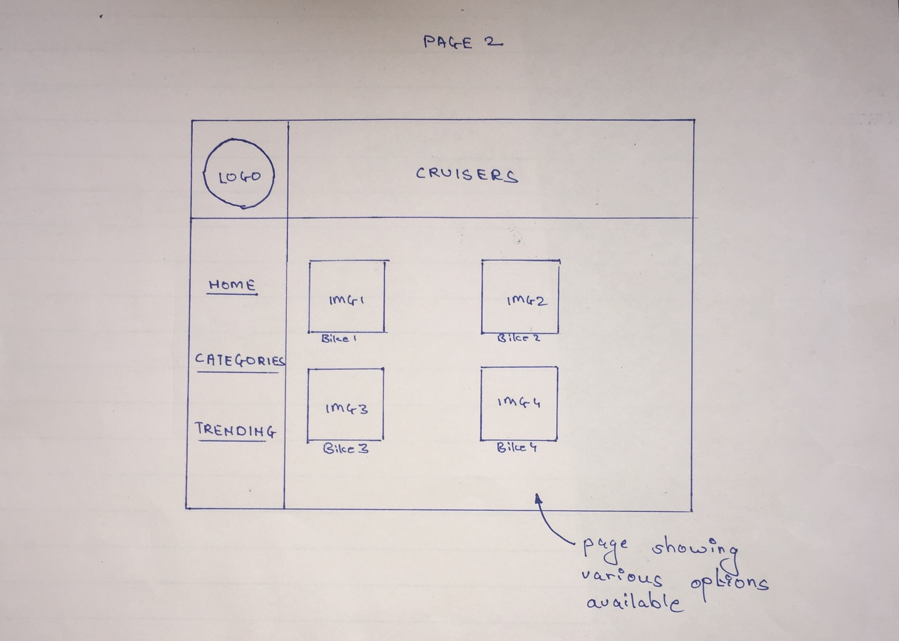
Category section (screen 2)

Slide 4
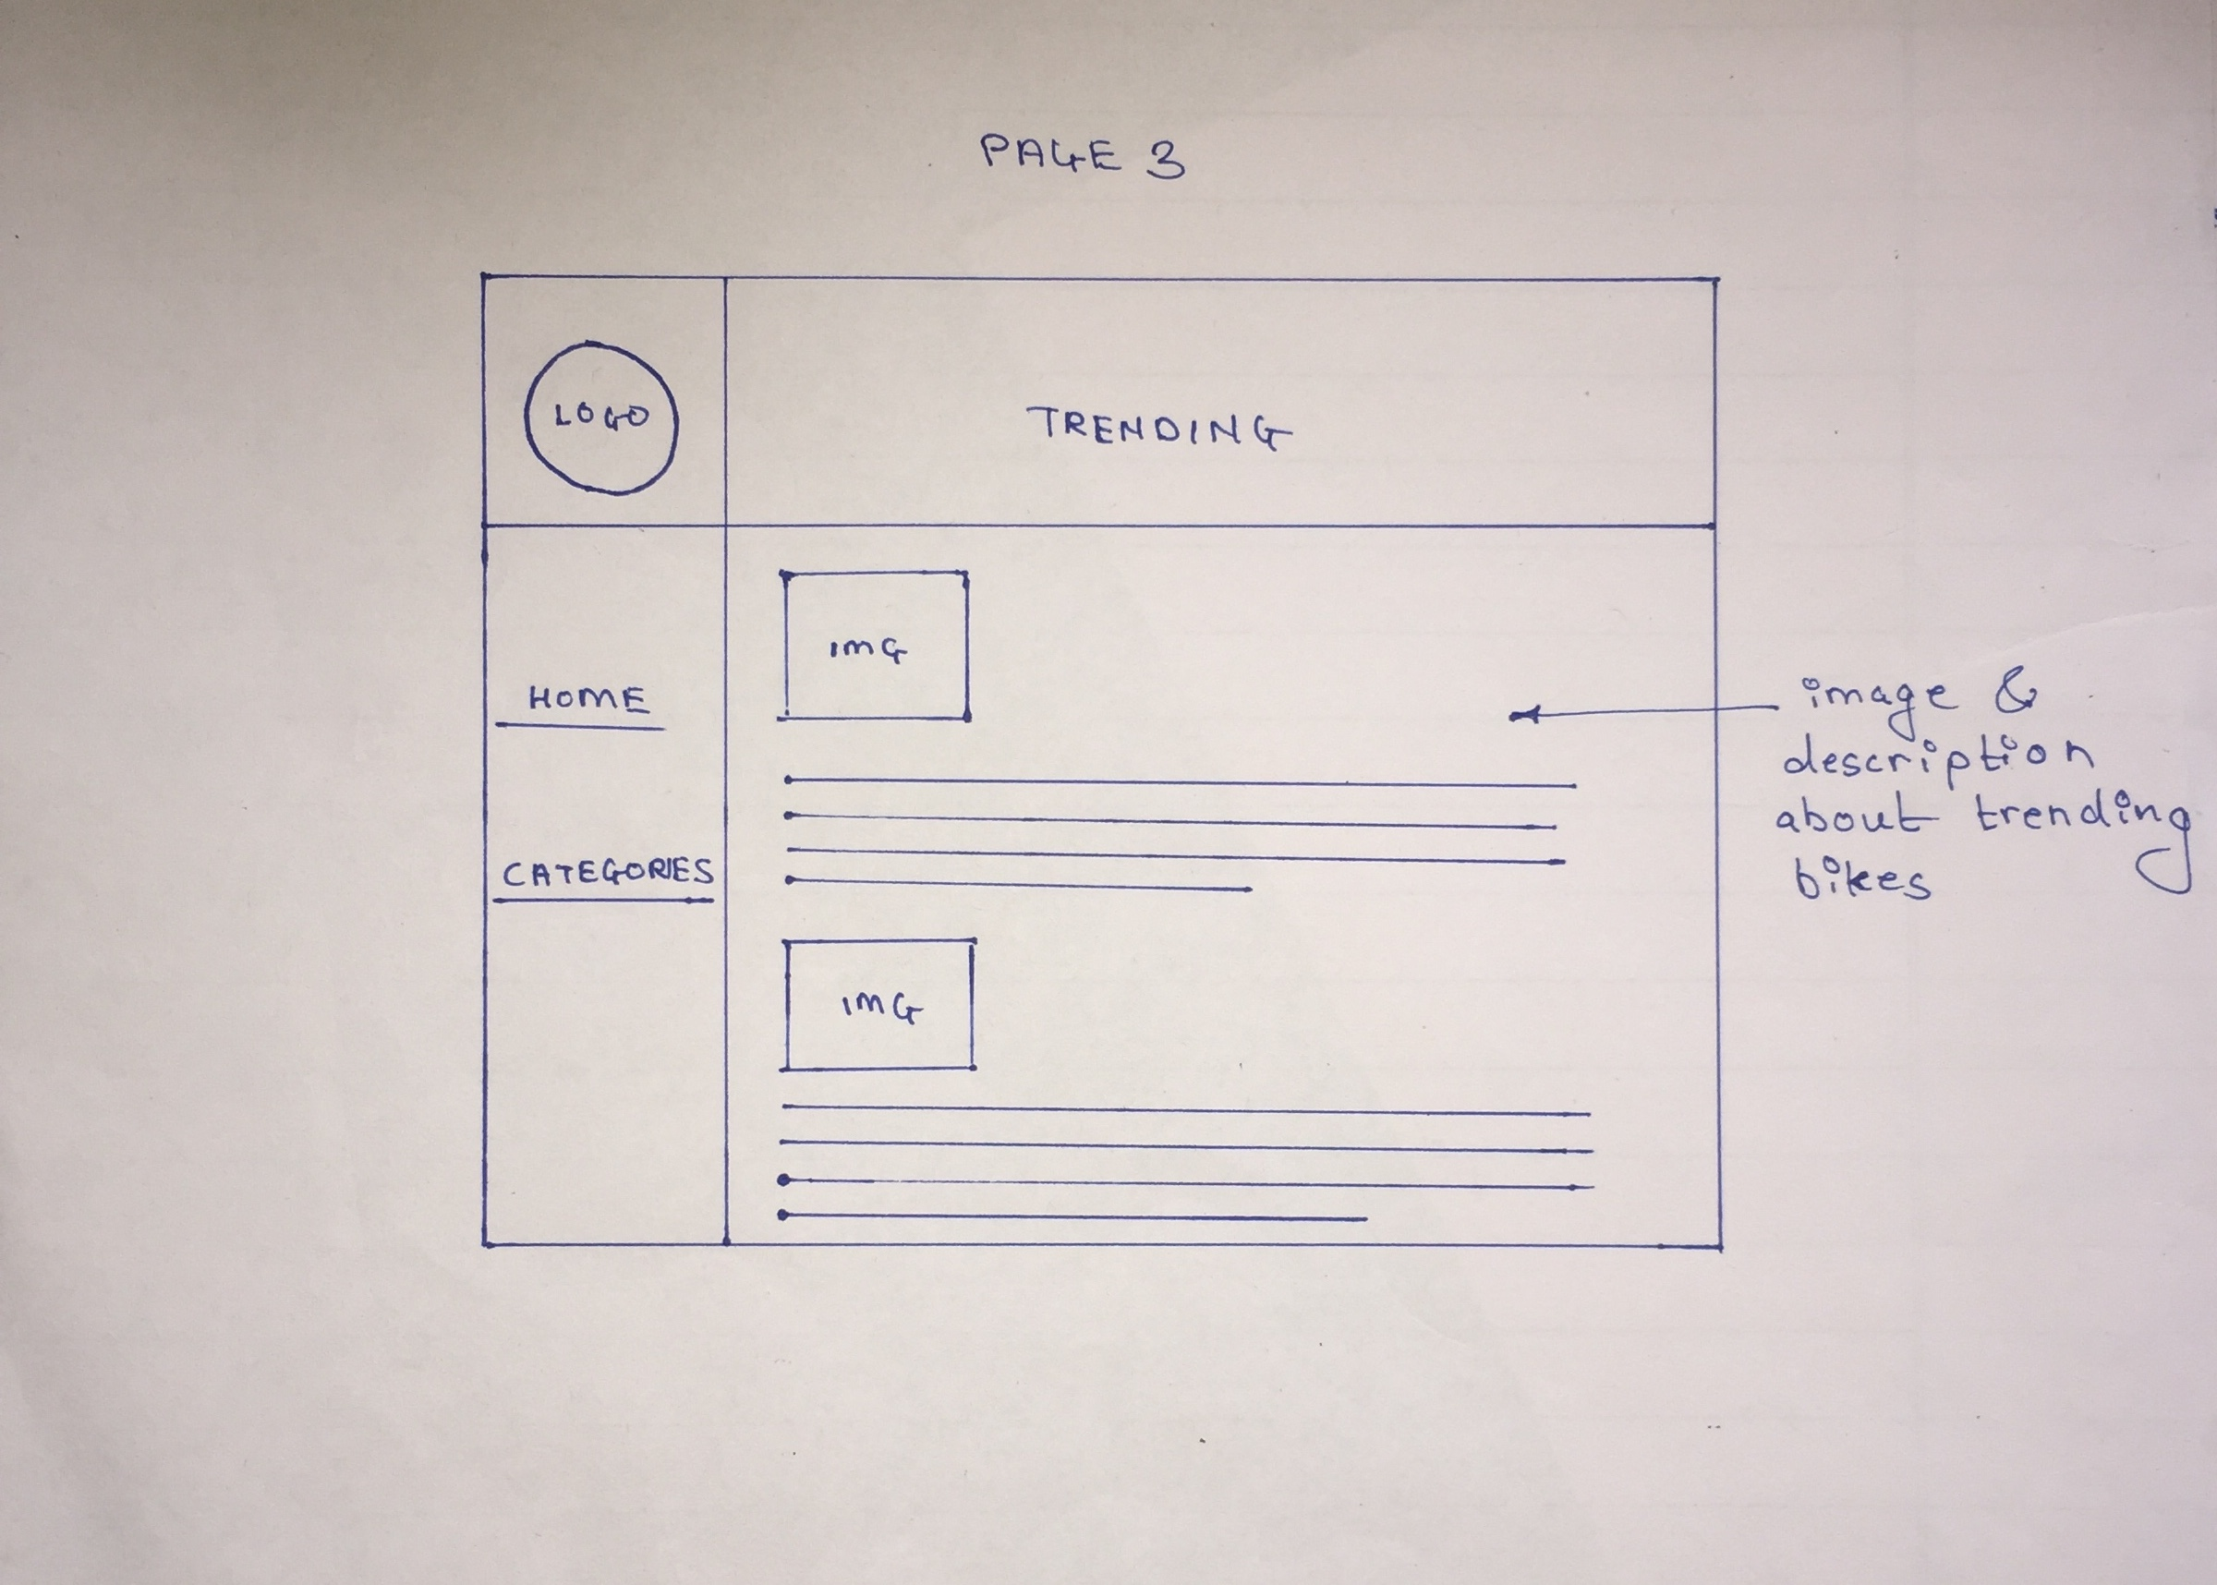
Trending section (screen 3)

Slide 5
References
https://www.w3schools.com/
http://www.powerdrift.com/
https://www.zigwheels.com/

